Slide 1
ANTI-NEOPLASTIC AGENTS
BY:
FARHAT SAGHIR.
PhD Scholar (Pharmaceutical Chemistry).
PUCP University of the Punjab, Lahore.

Slide 2
Antineoplastic agents
They are used for the treatment of cancer.
Neoplasm (In Greek, ‘neo’ means new and ‘plasm’ means formation) refers to the group of diseases caused by several agents- namely, Chemical compounds and radiant energy.
Cancer is characterized by an abnormal and uncontrolled division of cells, which produce tumors and invade adjacent normal tissues.
Often cancer cells separate themselves from the primary tumor and are carried by the lymphatic system reach distant sites of the organs where they divide and form secondary tumors (Metastasis).

Slide 3
Cancer Therapy
The specific approach used to treat cancer depends upon the specific type, location & stage of cancer. Generally a combination of different methods is used e.g. surgery + chemotherapy or radiation + chemotherapy.
Treatment of cancer includes:
SURGERY:
Surgery is one of the oldest approaches to the treatment of cancer. It should be possible to remove the tumor without causing significant damage to vital organs. Surgery can also be used for diagnostic purposes and in combination with other approaches.
RADIATION THERAPY:
It is used to shrink or destroy tumors. It does so by causing damage to DNA of tumor cells so that they die. Radiation therapy is not painful and anesthetics are not required but similar to surgery. This approach requires that the tumor should be localized.

Slide 4
3. IMMUNOTHERAPY
The methodology attempts to boost the level of lymphocytes specially T & B lymphocytes. T-cells destroy foreign cells including malignant and pre malignant cells. B-cells make antibodies in response to foreign proteins expressed by cancer cells. Currently therapy of this type primarily consist of the administration of highly purified interferon specially interferon-2.
4. CHEMOTHERAPY
Chemotherapeutic agents are complimentary to either surgery or radiation therapy in order to remove possible metastatic cells that still remain. Moreover some types of tumors are currently treated first with chemotherapeutic agent.
Cancer chemotherapy is generally non specific this means the drugs will kill not only cancerous cells but also normal cells so the patients undergoing chemotherapy suffer hair loss , depression of immune system, nausea, diarrhea etc.
These effects disappear once chemotherapy has been discontinue.

Slide 5
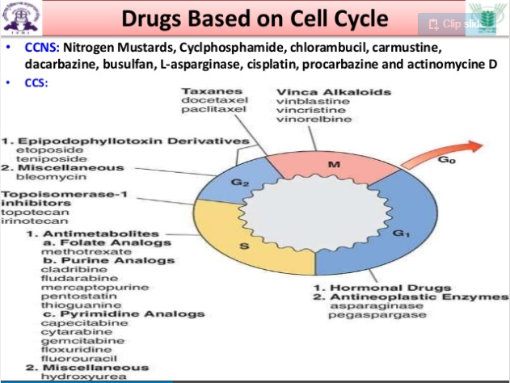
CELL CYCLE

Slide 6
G1 phase
G1 is the gap period between mitosis and the beginning of DNA synthesis. A phase that proceeds DNA synthesis and this phase cell enlarges and makes new proteins.
S- phase
It is the DNA synthesis phase.
G2 phase
An interval following the termination of DNA synthesis known as pre-mitotic interval.
M- phase
Mitotic phase in which the cell containing the double compliment of DNA divided into 2 daughter cells
Go phase
Resting phase each of the daughter cells may immediately re-enter the cell cycle or pass into a non proliferative phase refer to as Go stage. Go cells of certain specialized tissues may differentiate into functional cells that no longer are capable of division.

Slide 7
Biochemical basis of cancer
Mutations
Chemicals and environmental pollutants
Oncogenic viruses
Altered gene expression

Slide 8
Classification of Anti-neoplastic agents
Alkylating agents
Nitrogen mustard : Mechlorethamine, Melphalan, Chlorambucil, Cyclophosphamide.
Nitrosourea: Carmustine, Lomustine, Chlorozotocin.
Aziridines: Thiotepa, Benzotepa.
Aryl sulphonates: Busulphan.
Miscellaneous: Dacarbazine, Streptozotocin.

Slide 9
2. Antimetabolites
Folic acid antagonists: Methotrexate, Trimetrexate.
Purine antagonists: 6-Mercaptopurine, 6-Thioguanine and Flaudarabine.
Pyrimidine antagonists: 5-Fluorouracil and Cytarabine.
Amino acid antagonist: Azaserine

Slide 10
3. Antibiotics
Anthracyclines: Daunorubicin, Doxorubicin.
Miscellaneous: Actinomycin D, Mithramycin, Bleomycin and Mitomycin C.
4. Hormones and their Antagonists
Ethinyl estradiol, Tamoxifen and Megestrol.
5. Immunotherapy
Interferon-α- 2a recombinant
6. Miscellaneous
Cisplatin, Procarbazine, Testolactone and Hydroxyurea

Slide 11
7. Plant Products
Amides & imides
Colchicine, Narciclasine
Tertiary amines
Dimeric indole alkaloids:
Vincristine, vinblastine
ii. Dimeric tetrahydroisoquinolines:
Thalicapine, thalidasine
iii. Acyclic tertiary amines:
Solapalmitine, solapalmitenine
iv. Phenanthroquinilizidines:
Tylophorine, tylocrebrine, tylophorinine, phenanthroindolizidine.

Slide 12
Heterocyclic amines
Camptothecin
Lactones
Podophyllotoxin
Glycosides
Mithramycin

Slide 13
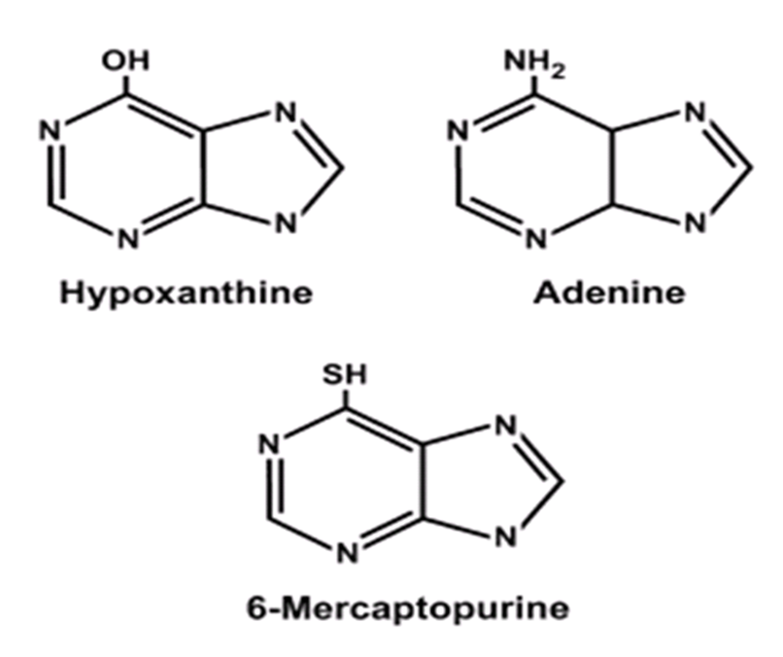
6 – MARCAPTOPURINE
Chemically: (3,7-Dihydropurine-6-thione)
Mercaptopurine is analog of adenine and hypoxanthine.

Slide 14
MECHANISM OF ACTION
6-mercaptupurine is converted to 6- mercaptopurine nucleotides leading to an inhibition of De novo purine nucleotide synthesis.
6-Mercaptopurine competes with hypoxanthine and guanine for the enzyme hypoxanthine-guanine phosphoribosyltransferase and is converted to thioinosinic acid.
This intracellular nucleotide inhibits several reactions involving inosinic mono phosphate (IMP) including the conversion of IMP to xanthylic acid and adenylic acid.
6-methylthioinosinate is formed by the methylation of thioinosinic monophosphate (TIMP)
Both TIMP and MTIMP have been reported to inhibit glutamine-5-phosphoribosylpyrophosphate amidotransferase, an enzyme required for purine ribonucleotide synthesis.

Slide 15
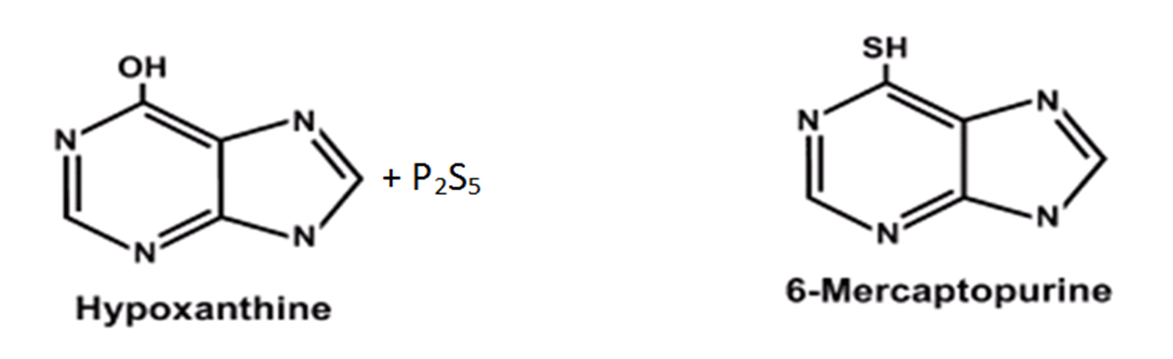
SYNTHESIS
It may be prepared by the interaction of hypoxanthine with phosphorus pentasulphide.

Slide 16
PHARMACOKINETICS
Absorption:
Rapidly absorbed orally within 1-2 hours after administration
Distribution:
Distributed in all tissues but does not cross the blood–brain barrier
Metabolism:
Three enzymes play major roles in the metabolism of mercaptopurine
xanthine oxidase
thiopurine methyltransferase
hypoxanthine–guanine phosphoribosyltransferase

Slide 17
Degradation is primarily by xanthine oxidase. urine contains intact mercaptopurine, thiouric acid, and a number of 6-methylated thiopurines
The methylthiopurines yield appreciable amounts of inorganic sulphate
Excretion:
The parent drug and its metabolites are excreted by the kidney

Slide 18
SAR
6-MP and its anabolite 6-thioinosinate are structural analogues of purine and therefore they are incorporated into DNA and RNA.
In this manner, fraudulent nucleic acids may be formed that will be lethal to the neoplasm.
DOSE
Initial oral dose for children and adults is 2.5 mg/kg body weight daily.

Slide 19
USES
It is found to inhibit experimental orthoimmune encephalomyelitis and thyroiditis and used in combination with vincristine, methotrexate and prednisone in the treatment of childhood leukemia.
Immunosuppressive agent in patients receiving solid-organ transplants, and in rheumatology, dermatology, and gastroenterology
A corticosteroid-sparing agent.

Slide 20
5-FLUOROURACIL
Chemically: Fluorouracil (5-FU) is a pyrimidine analogue

Slide 21
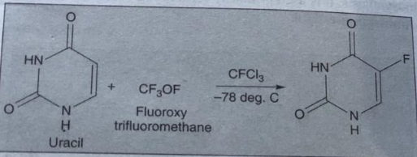
SYNTHESIS
It is prepared by treating uracil with fluoroxy trifluoromethane at -78^{ο}C.

Slide 22
MECHANISM OF ACTION
It produces anticancer effect in S phase of cell cycle.
5-FU has been acting principally as a thymidylate synthase inhibitor, which is an enzyme involved in the synthesis of pyrimidine for DNA replication.
Its metabolite, 5-fluorodeoxyuridine-5ʹ-monophosphate (5-FdUMP), blocks the synthesis of thymidylic and eventually of deoxyribonucleic acid (DNA).
It also gets incorporated into the RNA directly.

Slide 23
USES
It is the first choice for the treatment of colon cancer.
It is employed primarily in the treatment of slow growing solid tumors (e.g. Colorectal, Breast, prostate, Ovarian, Pancreatic and gastric carcinoma) for which surgery or irradiation is not possible.
It is also found to be beneficial in tropical treatment of premalignant solar keratosis.

Slide 24
METHOTREXATE
Is an antimetabolite
It also blocks thymidylate synthetase and dihydrofolate reductase (DHFR) enzyme
It binds in a cavity that is 15ºA deep and cuts across the face of the enzyme
At least 13 amino acid are involved in this binding
The binding to the enzyme is pH dependent and maximum at pH 6
It binds to enzyme 10³ times stronger due to hydrogen bonding of 2, 4 amino group
Kills the cells by inhibiting DNA synthesis in S (synthesis)-phase of cell life cycle

Slide 25
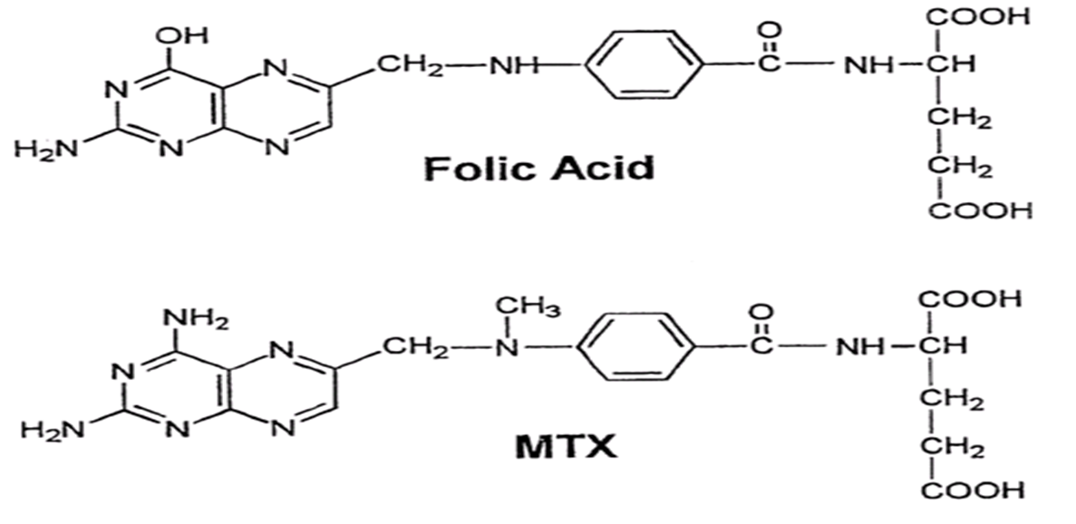
CHEMISTRY
Methotrexate (4-amino-N methyl pteroylglutamic acid) is a potent competitive antagonist (inhibitor) of enzyme dihydrofolate reductase (DHFR)
It is structurally similar to folic acid, which is the natural substrate for this enzyme
MTX. differs from folic acid in two areas: Amino group at carbon-4 takes the place of hydroxyl group & a methyl group at the N-10 position substitutes for the hydrogen atom

Slide 26
MECHANISM OF ACTION
  Inhibits DNA synthesis by competitively and irreversibly inhibiting enzyme, dihydrofolate reductase (DHFR), which converts dihydrofolate to tetrahydrofolate and thus prevents effectively the conversion of deoxyuridylate to thymidylate thus ultimately blocks synthesis of DNA required urgently for the cellular replication.

Slide 27
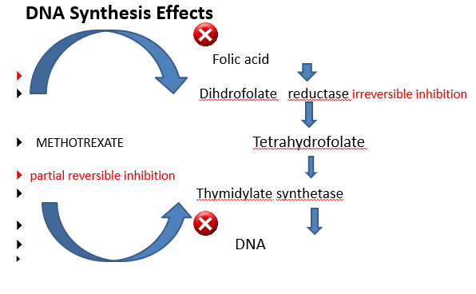

Slide 28
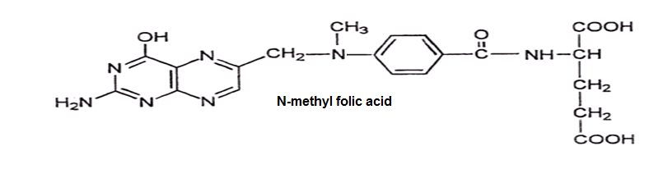
STRUCTURE ACTIVITY RELATIONSHIP (SAR)
N-10 methyl folic acid has antimetabolite activity but not the anticancer activity

Slide 29
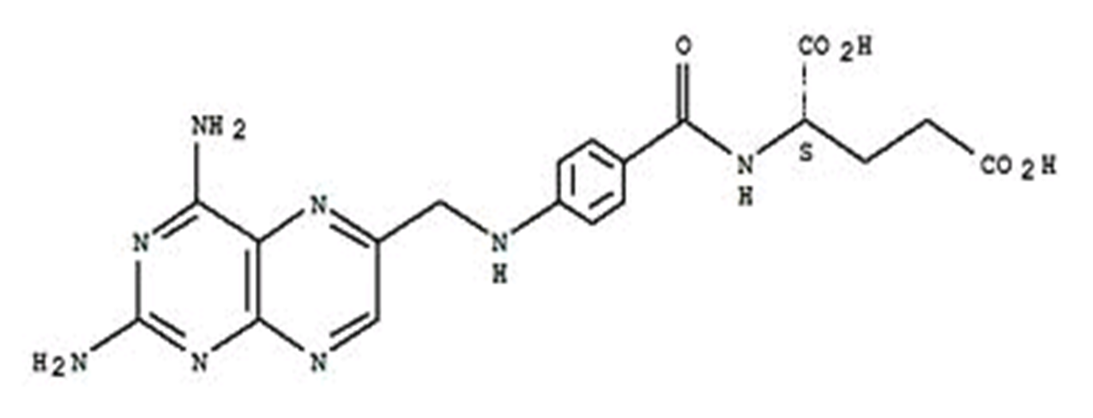
Further modifications indicated that 4 amino derivative of folic acid has good anticancer activity
Another analogue 4 amino N methyl derivative (Methotrexate) has anti cancer activity.

Slide 30
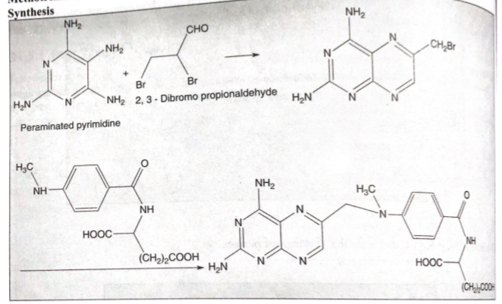
SYNTHESIS

Slide 31
ABSOPTION AND DISTRIBUTION
Methotrexate can be administered orally, intravenously, intramuscularly or subcutaneously
It is rapidly absorbed through the G.I. tract, although peak level occurs more slowly (1 h after ingestion)
The drug is well distributed throughout the body except in the brain where intrathecal injection is used in some chemotherapy regimens

Slide 32
USES
It is extremely employed for the treatment of acute lymphoblastic leukemia
It is invariably used in combination therapy for palliative management of lung cancer, breast cancer and epidermoid cancers of the head.
It is frequently recommended for the treatment and prophylaxis of meningeal leukemia.
It is also of value in chloricacinoma and related trophoblastic tumors of women.

Slide 33
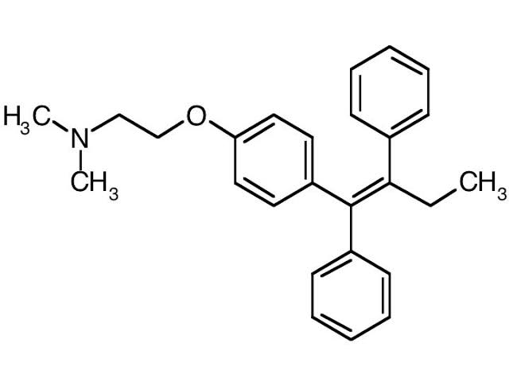
TAMOXIFEN
Tamoxifen is an antagonist of the estrogen receptor in breast tissue.
In other tissues such as the endometrium, it behaves as an agonist, hence tamoxifen may be characterized as a mixed agonist/antagonist.

Slide 34
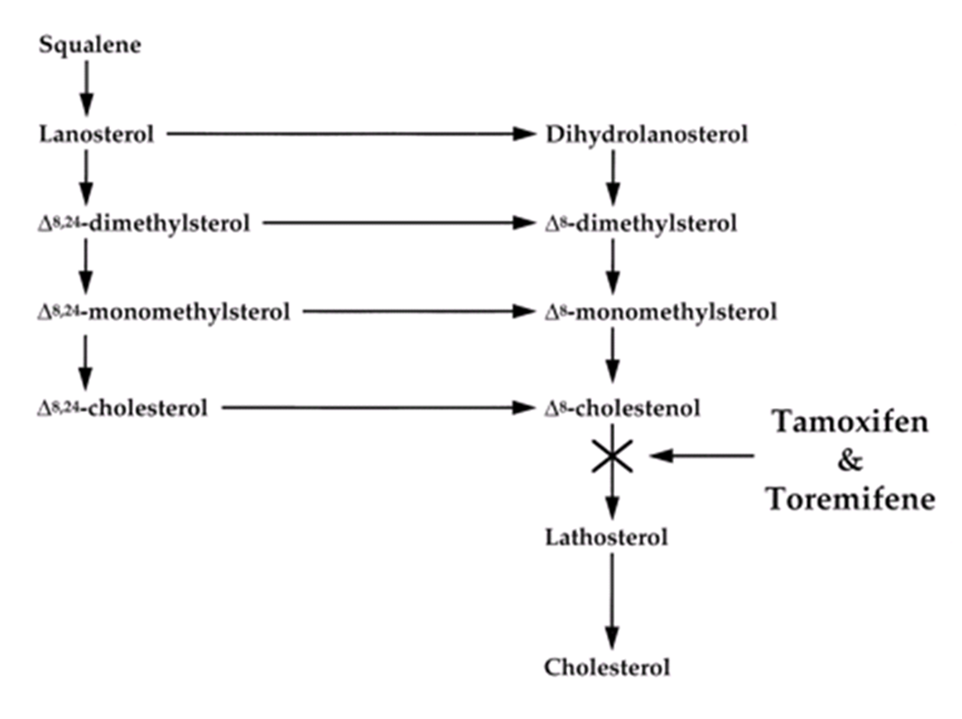
MECHANISM OF ACTION
The effects of toremifene and tamoxifen on cholesterol synthesis.
1. These compounds interfere with cholesterol synthesis by inhibiting the conversion of Δ8-cholestenol to lathosterol.

Slide 35
2. Competes with estradiol for estrogen receptors in target breast tissues; blocking transforming growth factor-β (TGF- β) pathway and decreases autocrine stimulation of breast cancer growth

Slide 36
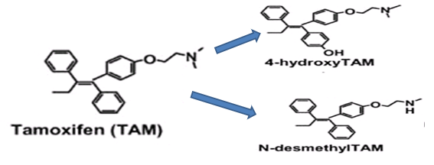
Being antagonist, it blocks oestrogen receptors in breast tissue via its active metabolites, 4-hydroxytamoxifen and N-desmethyl tamoxifen. They have 30-100 times more affinity to the oestrogen receptor than that of tamoxifen.
It is a standard endocrine (anti-oestrogen) therapy for hormone receptor-positive early breast cancer in pre-menopausal women

Slide 37
Some breast cancer cells require oestrogen to grow. Oestrogen binds to and activates the oestrogen receptor in these cells.
Tamoxifen is metabolized into compounds that also bind to the oestrogen receptor but do not activate it. Hence breast cancer cell growth is blocked.
It is a non-steroidal agent with potent anti-oestrogenic properties and competes to oestrogen for binding sites in breast and other tissues.
Tamoxifen causes cells to remain in the G₀ and G₁ phases of the cell cycle. Because it prevents (pre)cancerous cells from dividing but does not cause cell death
Hence, tamoxifen is cytostatic rather than cytocidal.

Slide 38
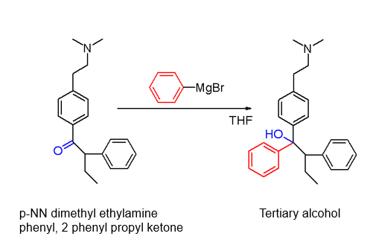
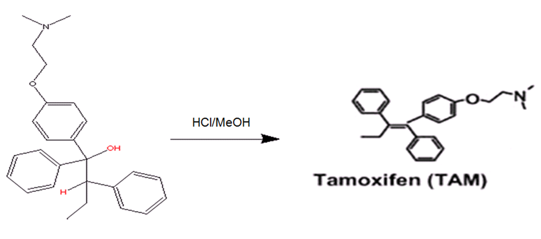
SYNTHESIS

Slide 39
PHARMACOKINETICS
Absorption: oral
Metabolism: Liver
Excretion: unchanged and metabolites are excreted predominantly through bile into feces

Slide 40
USES
Breast Cancer Treatment:
Tamoxifen is currently used for the treatment of both early and advanced ER+ (Estrogen receptor positive) breast cancer in pre and post-menopausal women.
Additionally, it is the most common hormone treatment for male breast cancer.
Infertility:
Tamoxifen is used to treat infertility in women with anovulatory disorders.
Gynecomastia:
It is used to prevent estrogen related gynecomastia resulting from elevated estrogenic levels in conjunction with steroid use. It is taken as a preventative measure in small doses or used at the onset of any symptoms e.g. Nipples soreness/ sensitivity.
Bipolar Disorder:
Effective in the treatment of mania in patients with bipolar disorder by blocking protein kinase C (PKC), an enzyme that regulates neuron activity in the brain.

Slide 41
VINCRISTINE
Vincristine is a Vinca alkaloid Obtained from periwinkle flower Vinca rosea or Catharanthus roseus is important clinical agent to treat cancer.

Slide 42
CHEMISTRY
Composed of the fusion of two multi-ringed units:
  vindoline (indoline containing moiety)
  catharanthine (indole containing moiety)
They contain tertiary amino groups that form salts, freely soluble in water.

Slide 43
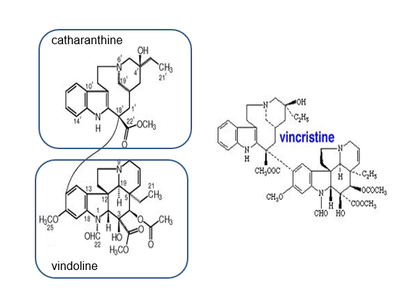

Slide 44
MECHANISM OF ACTION
They block mitosis and arrest metaphase.
They bind specifically with tubulin dimers at a specific recognition site on the protein and cause depolymerization.
The tubulin drug complex is able to form paracrystaline aggregates, which reduces the concentration of the dimers and pushes the equilibrium towards shrinking of the microtubules.
Treated cells loose the ability to progress through mitosis correctly because of poorly formed mitotic spindles. The damaged cells then die.

Slide 45
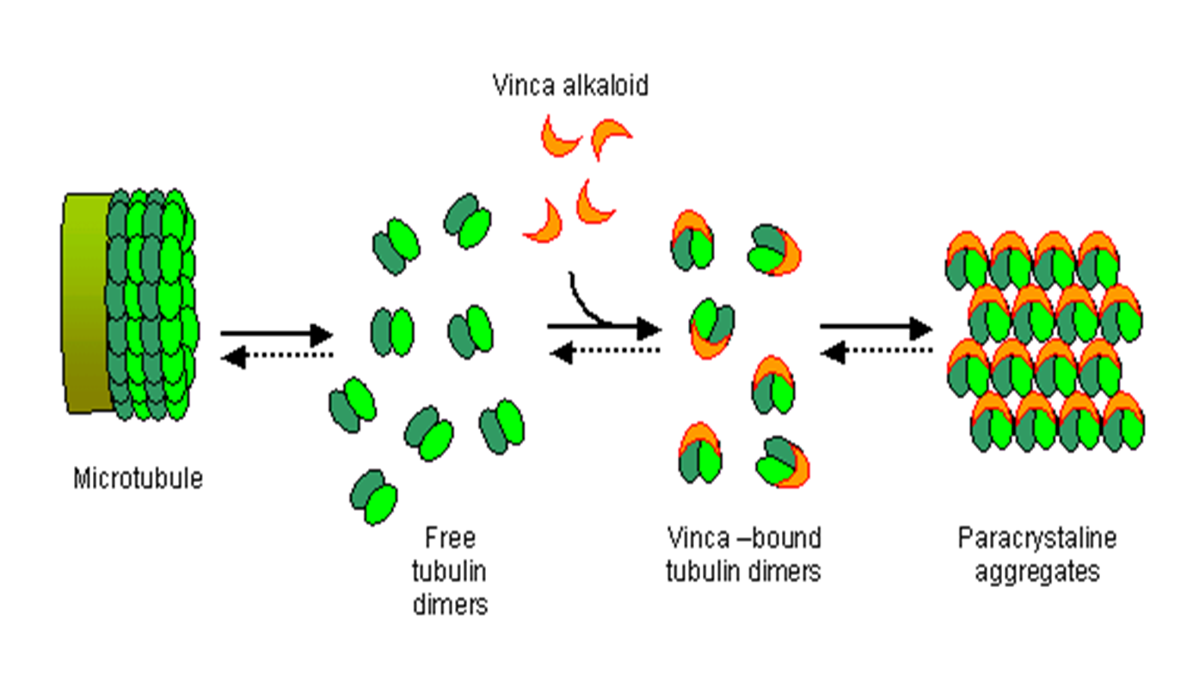

Slide 46
USES
Acute leukemia
Hodgkin’s disease
Testicular cell tumor
Lymphocytic lymphoma
Breast carcinoma
Histicytic lymphoma

Slide 47
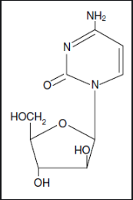
CYTARABINE
Cytarabine is an example of Pyrimidine antimetabolites.
It is available as a water soluble sterile powder for I/V, intrathecal and S/C use.

Slide 48
Mechanism of action
Cytarabine act as a prodrug.
It is phosphorylated in the cells to corresponding phosphates and acts as a competitive inhibitor of DNA polymerase.
This can lead to chain termination or prevent replication of DNA.

Slide 49
Pharmacokinetics
The drug is not active orally because of extensive deamination to inactive metabolites.
Hence I/V administration is an absolute necessity.
60% of the drug gets metabolized to CO2.
More than 15% is excreted unchanged through urine.
Plasma ½ life is 10 minutes.
Rapidly metabolized to inactive product called arabinofuranosyl Uracil.

Slide 50
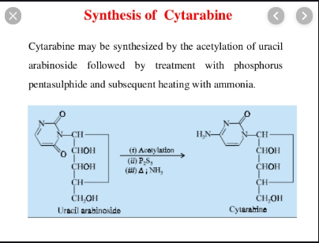
Synthesis

Slide 51
SAR
In Cytarabine, the sugar moiety is modified. In this case the sugar moiety is arabinose in place of de-ribose.
It must be converted to its monophosphate and then to triphosphate derivative.
This change in configuration of 2ʹ-carbon results in a compound that has multiple activities.
They are structurally related to endogenous substrate.
They antagonize the structural modification may be on pyrimidine ring or if present on pentose sugar group.
Deamination of amino group results into a metabolite with no activity.

Slide 52
Uses
Adult and childhood leukemia.
Acute granulocytic leukemia and more effective when combined with Daunorubicin and thioguanine.

Slide 53
Dose
Plasma levels of 0.01-0.05 µg/ml are required for cytotoxic effects and they are achievable with the use of continuous or sequential bolus doses of 100-200 mg/m2 body surface area (BSA).
Usual adult and children dose for leukemia is 2mg/ kg/day I/V can also be given intrathecally, I/M, S/C or by slow I/V infusion.

Slide 54
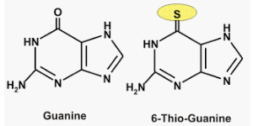
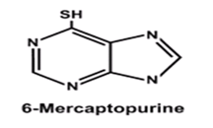
THIOGUANINE
6-Thioguanine is an antimetabolite structurally related to 6-Mercaptopurine.

Slide 55
Mechanism of action
6-thioguanine generally parallels the activity of 6-MP.
Like 6-MP, 6-thioguanine is first converted to its monophosphate 6-TGMP then into diphosphate derivative 6-TGDP and then to triphosphate 6-TGTP by same enzyme HPGRT.
The ribosylated triphosphate of 6-TG can be incorporated into RNA or after reduction to the 2ʹ-deoxy derivative into DNA.
Resultantly 6-TG may inhibit DNA replication because of the inability of the replication enzymes to recognize 6-Thioguanine.

Slide 56
Pharmacokinetics
Oral Thioguanine is poorly absorbed and injectable form is supplied in 75mg vials reconstituted by adding 5ml of NaCl for injection.
Thioguanine is metabolized to methyl thioguanine, thiouric acid, methyl thioxanthine and thioxanthine.
In contrast to 6-MP, thioguanine may be continued in the usual dose when allupurinol is used to inhibit uric acid formation.
Although oral absorption is poor but tablet forms are also available.

Slide 57
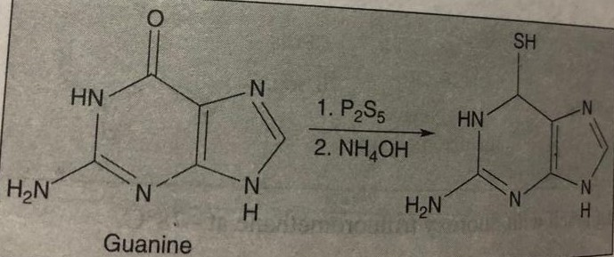
Synthesis

Slide 58
SAR
Same as 6-MP.
Uses
It is used in treating acute leukemias specially in combination with cytarabine.
It founds an important role in organ transplantation as an immunosuppressant agent.
Chief toxic effect is delayed bone marrow depression resulted in leukopenia, leukocytopenia and eventually thrombocytopenia and bleeding at last.

Slide 59
Dose
The usual initial dose is 2mg/ kg daily by the oral route.
If there is improvement after 4 weeks.
The dosage is increased to 3mg/ kg daily.

Slide 60
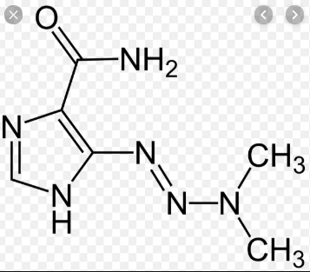
DACARBAZINE
Dimethyl triazenyl imidazole carboxamide (DTIC).
Decarbazine is an alkylating agent.
Alkylating agents act by alkylation of DNA.
The most common site of alkylation is N7 position of guanine.
Other sites on DNA bases or the phosphate oxygens of DNA backbone may also be alkylated.
The alkylating agents appear to be the most effective in the G1or S phase.

Slide 61
Mechanism of action
Decarbazine is a prodrug which is activated by N-demethylation in the liver catalyzed by cytochrome p450 enzymes.
Initial demethylation to Methyl triezenyl imidazole carboxamide (MTIC) is followed by formation of Diazomethane a potent alkylating agent.

Slide 62
Pharmacokinetics
Decarbazine must be administered I/V. It has a large Vd and is rapidly removed from the plasma.
It has a ½ life of 30 minutes.
It is metabolized in liver and products appear in the urine.
Toxicity includes bone marrow depression, GI erosions and vomiting.

Slide 63
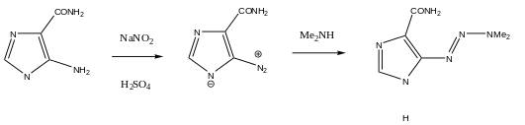
Synthesis
Decarbazine is synthesized from 5-aminoimidazole-4-carboxamide reaction with NaNo2 to convert into diazonium salt which upon reaction with dimethylamine convert into Decarbazine.

Slide 64
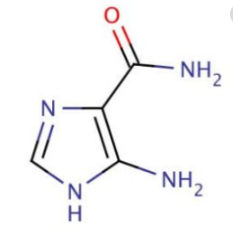

SAR
In body Decarbazine is converted to AIC (5-amino imidazole, 4-carboxamide) and a methyl diazonium ion.
Methy diazonium ion is a strong alkylating agent, reaction of this ion with DNA or RNA results in methylation mainly at 7th position of guanine where N7 is a nucleophilic group.

Slide 65
Uses
Hodgkin’s lymphoma
Metastatic malignant melanoma
Also used in combination therapy for several soft tissues sarcomas.
Leukopenia and thrombocytopenia are the most serious side effects.

Slide 66
Dose
The recommended daily dosage is 2-4.5mg/ kg for 10 days with repetition at 4 weeks intervals.
Extravasation of drug during injection may result in severe pain.

